Slide 1
A Guide to Surviving in Bishkek, Kyrgyzstan
WHAT IT MEANS TO BE A STUDENT

Slide 2
1. Remind yourself daily how courageous you are.
Changing space is a major shock to our emotional and mental equilibrium.
Our homes are our safe places, our nests to hide and recover and escape the outside world, especially for those of us who are especially sensitive or clairvoyant.
You no longer have that safe space, and you are faced with the task of having to create it again from the ground up.
Tell yourself that you are brave and strong, and believe it.

Slide 3
2. Lose your fear of solitude.
Don’t be afraid to explore on your own.
Give yourself the gift of independence, and establish that quality from the start.
All you need is you.

Slide 4
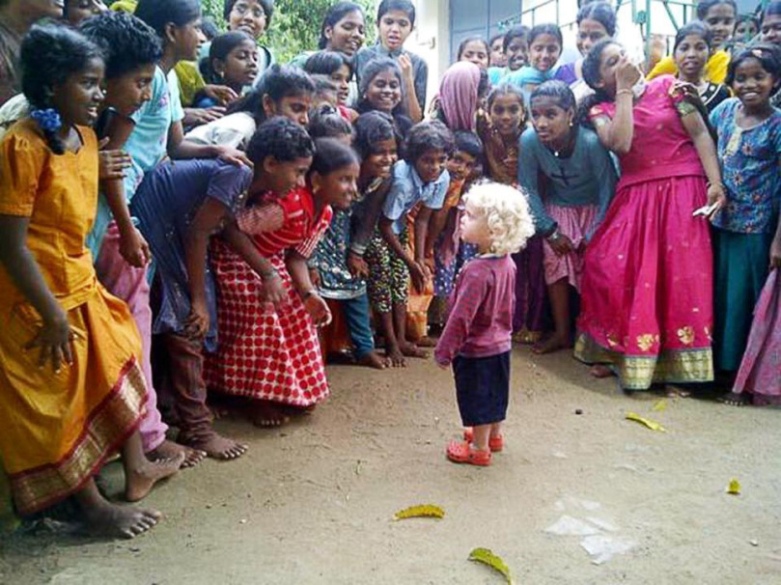
3. Be gentle on yourself.
Don’t be afraid to be afraid.
Be gentle on yourself and accepting of the way you feel.
Notes:
One of the biggest things that I struggle with is accepting that fear or sadness isn’t weakness. I’m not any less of a person because I felt anxious and scared and questioned my decisions when I first moved to a new place. In fact, it takes strength to feel those feelings to the fullest and not just shove them aside to manifest themselves later in uglier ways. Be gentle on yourself and accepting of the way you feel.

Slide 5
4. Appreciate the differences, don’t compare them.
No living situation will be the same. When you transition to a new place and a new home, you are embarking on a completely unique adventure.
Embrace all the new parts of your home that you will grow to love, rather than focusing on what it lacks.

Slide 6
5. Find the beauty in small things.
Whenever you feel like you’re forgetting to be grateful, take a moment to be appreciative of the things around you, no matter how insignificant they made be.
For example, “I’m grateful for my turquoise nail polish, which makes me feel happy when I look at it.” It’s a simple practice, but it makes a huge impact.

Slide 7
6. Maintain your relationships.
But what I’m learning more and more is that friendships, even long distance friendships, will help you feel stable and grounded when your world is turned upside down.
One beautiful thing about all these crazy advances in technology is that it allows us to stay connected and feel close to the ones we love when we’re far away.

Slide 8
7. Set time each day to do what you love and what inspires you.
Although it pains me to admit it, a routine helps significantly in adjusting to a new place.
Intentionally make time every day, no matter if its five minutes or two hours, to do things that you love and that make you genuinely happy.

Slide 9
8. Get involved
When you feel uncomfortable, sometimes you just have to dive in fearlessly.
The more you put yourself in places that fit your interests and lifestyle, the easier it will be to find people you resonate with.
The more involved you are in the community you’re building a life in, the easier it will be to feel at home.
DO SPORTS!

Slide 10
9. Eat healthy food
For the first time in your life, you're on your own, making decisions about what you should and shouldn't eat.
You're surrounded by salty snacks and sweets, you're almost always in a rush, and controlling what you consume without a kitchen at your disposal can be majorly challenging.
But college is also the place where you can start establishing good eating patterns that will last a lifetime (and where you can break the bad ones, too!).

Slide 11
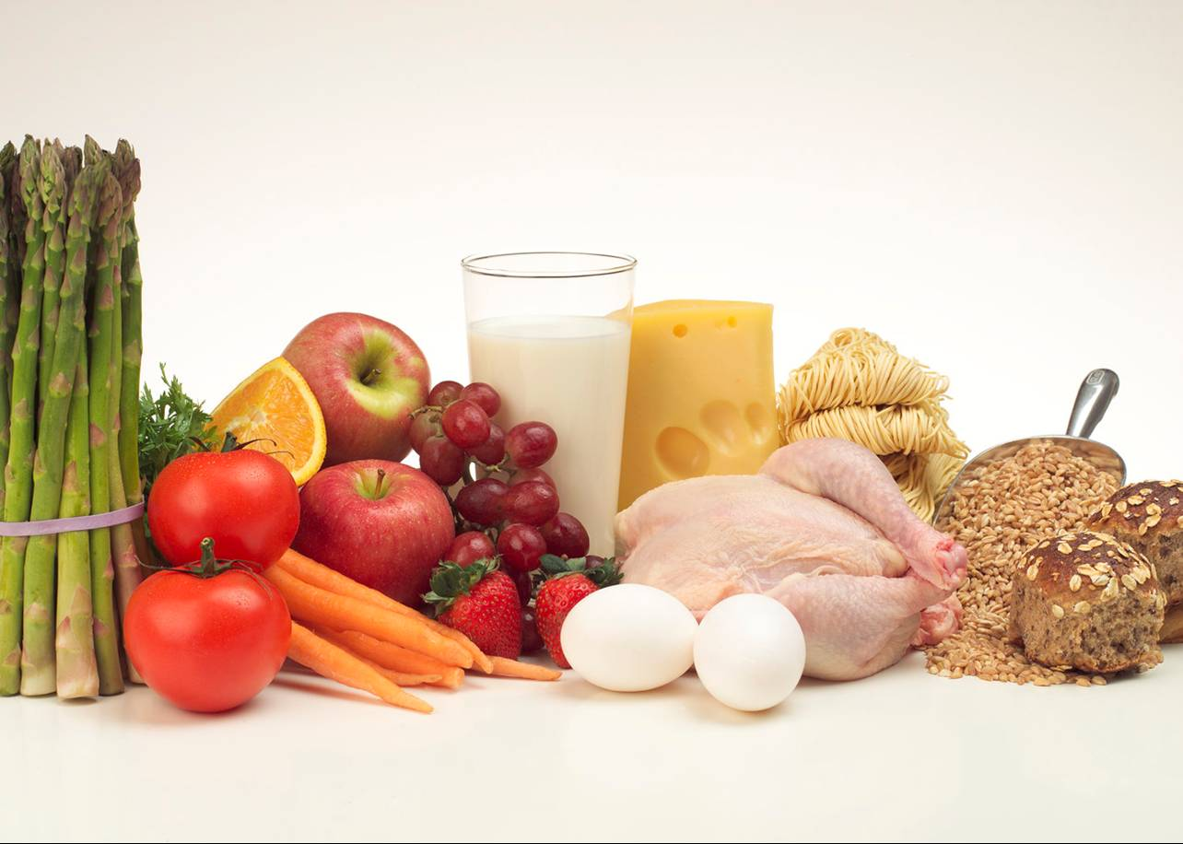
Always get the fruit
Listen to your body
Experiment with what you're eating (Eat mindfully and pay attention to what works for your body and what doesn't. Ask yourself: How does that food affect my mood, my energy, my sleep, and my digestion?)
Eat high-quality junk food (if you're going to indulge in food you know isn't especially good for you, you're better off going with something a little higher quality and really savoring it)
DRINK LOTS OF WATER!!! (8 glasses per day)

Slide 12
ROUTINE SUGGESTIONS:
Breakfast: oatmeal (or any porridge, eggs, cereal, yogurt, fruit, nuts). (if it's an exam (TOEFL test) day, I'd recommend grapes, berries, and walnuts for optimal brain health and focus!)
Lunch: It's easy to skip lunch, but it's the meal that can set you up for success for the rest of the afternoon. A salad and hearty soup combination works the best.
Snack: That feeling where you know you have to eat something fast, but you're not sure what? It is called that snack stress, and it's to be avoided at all costs. Throw a baggie of nuts or a snack bar (pick one that has less than 15 grams of sugar per serving!) in your backpack. And remember, you can never go wrong with raw veggies.
Dinner: For your biggest meal of the day, go with a serving of fish, chicken, or meat with a side of vegetables. (Try to avoid sugar, carbohydrates.)
Late-night snack: Crackers and apples is the best option. Avoid eating salty foods like sausage, pizza, etc.: Extra salty things have a tendency to make you feel bloated and tired the next day.

Slide 13
Staying healthy is easy
You wake up with a sore throat the day you're set to make a major presentation, a salad leaves you with grumbling indigestion, or you overdo it at the gym and arrive to the dorm with a stiff neck. Wouldn't it be great to have a live-in doctor/therapist/trainer to tend to your everyday aches and pains?
Here's the next best thing: all-natural, expert-recommended ways to treat ailments quickly, safely, and effectively at home.
Eat healthy: avoid fats, coke, candy, kurut, carbohydrates, fried and salty food
If you get a cold: drink lots of fluids (non-stop)-lots of black tea with lemon, raspberry or black currant jam

Slide 14
Basic health tips:
If you get a cold/flu:
drink lots of fluids (non-stop)-lots of hot black tea with lemon, mint, raspberry or black currant jam (around two liters).
Roll up in a blanket and sweat out the cold. (then change into dry clothes).
If possible have some hot chicken broth.
Also, eat lots of garlic, onion, whole lemons
If you have ear infection: use the warm ironed cloth on your ear, several drops of Otipax (medicine) into your ear
If your tonsils swell/sore throat:
Follow the same routine as for the cold
Make an application of medical spirits (vodka) on a cloth to your neck (1 hour)
Have a hot bath for your feet
Oil your hot feet with Vaseline and put warm cotton socks
Or put mustard plasters (gorchichniki) into your socks for night

Slide 15
Do not overuse drugs/medicine
If you have food poisoning:
Drink around 3-4 liters of warm water with manganese crystals (marganzovka) and try to throw up (vomit)
Take tablets of Activated Coal (1 per ten kilos of your weight)
Then drink warm black tea with honey/sugar
If you have indigestion
/stomachache/diarrhea
Take two tablets of Linex every four hours the first day.
Drink lots of hot black tea with honey or crystallized sugar (navat)
Massage your belly clockwise with some Vaseline and tightly wrap a cotton kerchief around your belly.
Drink Airan (yogurt) with your food to easily digest food. (preventive method)

Slide 16
Feeling Sad? – Eat Bananas!
If you feel dizzy/ have headaches/feel depressed:
do not eat too much sugar, drink caffeine or salt.
Go out for a walk/ you need lots of fresh air
Drink green tea with mint or some chamomile tea
Eat some dark chocolate, a banana, an orange, some almonds or drink tomato juice (all these contain hormones of happiness)!

Slide 17
Top Tips
Do regular physical activities!!! (walk from dorm to campus)
Drink lots of water!!!
Keep your feet warm!!!
An apple a day keeps the doctor away!!!
Smile!!!
Talk to people!!!
THANK YOU!!!!

